Slide 1
Simulations: Test plan
Notes:
The framework have matured beyond that basic functionality,
Now I will show some advanced examples

Slide 2
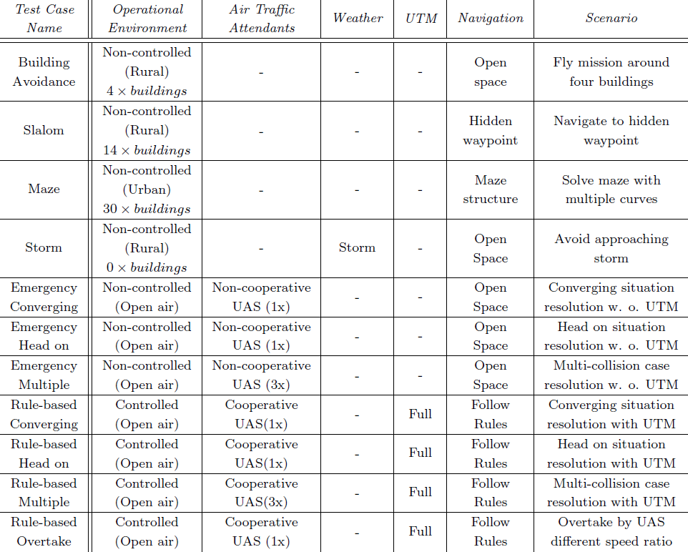
Test plan

Slide 3
Simulations Maze Solver Storm Avoidance
Notes:
The framework have matured beyond that basic functionality,
Now I will show some advanced examples

Slide 4
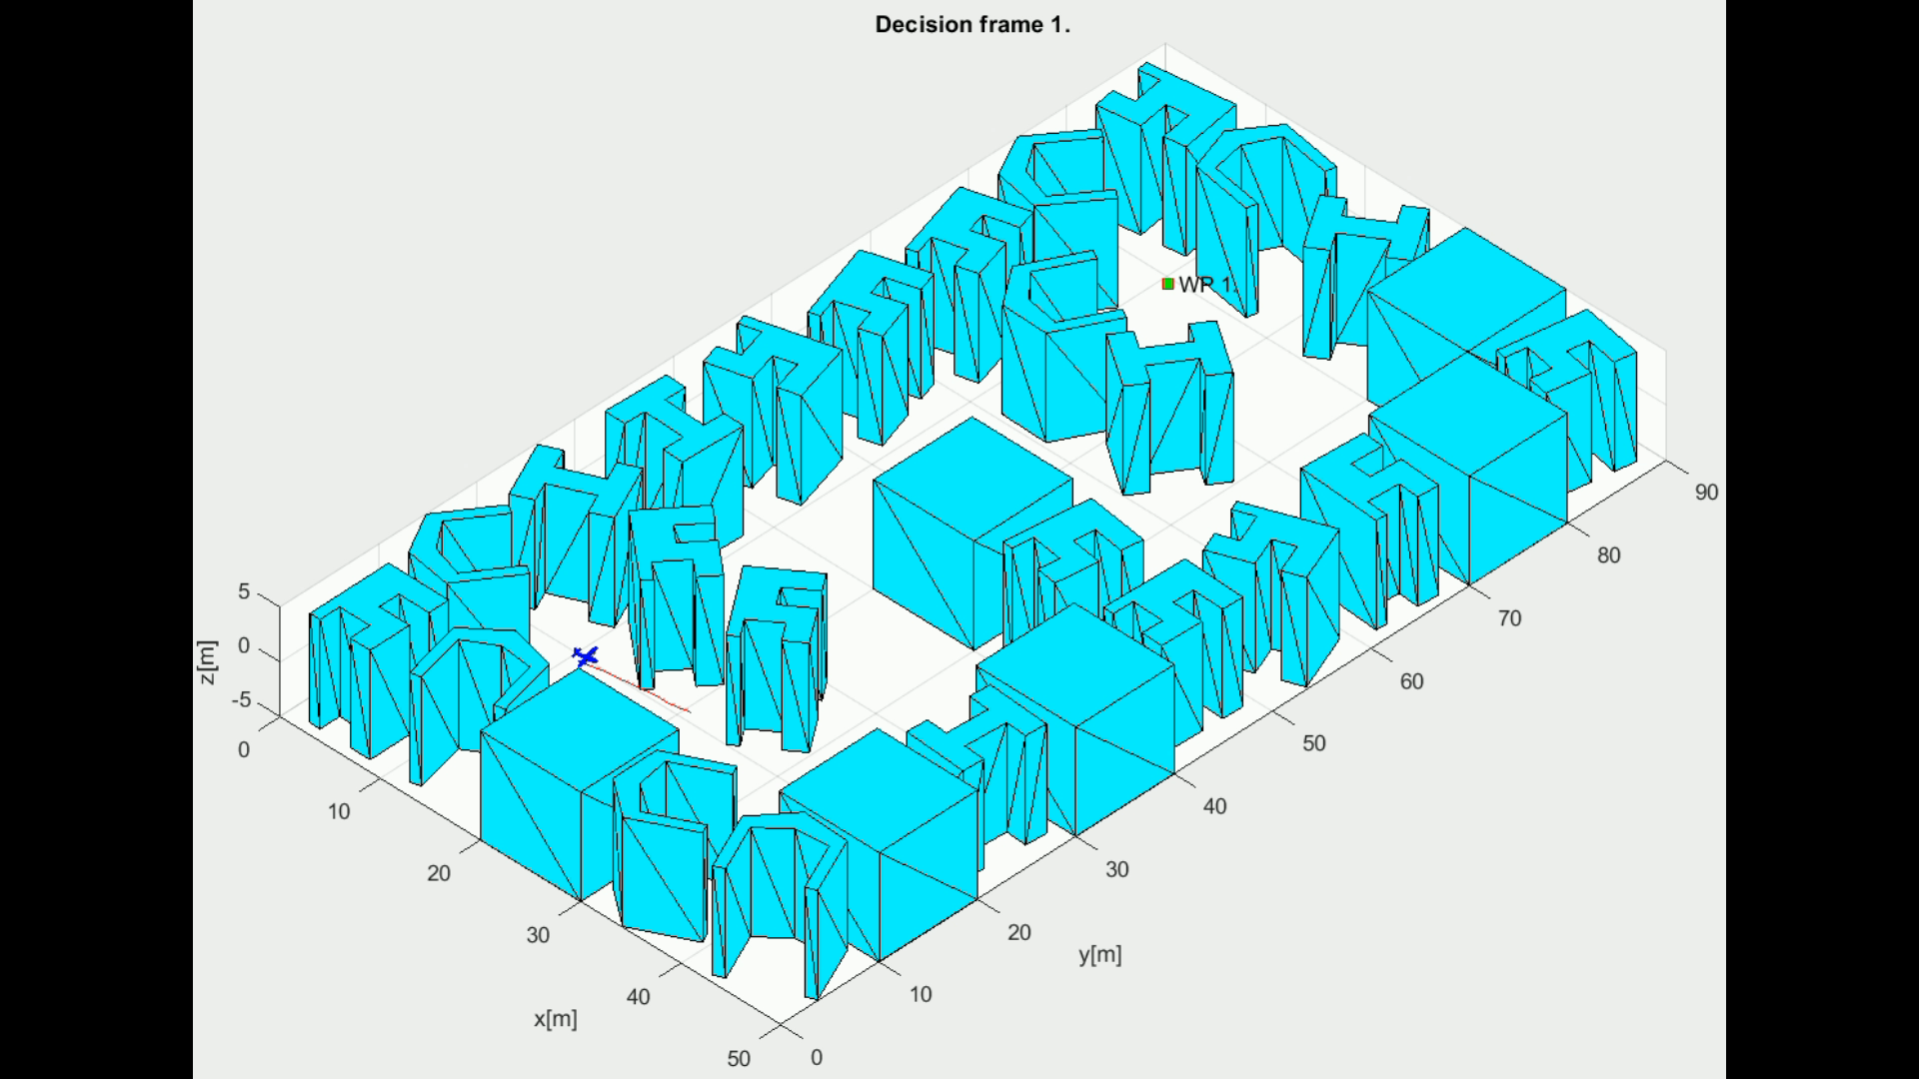
Scenario (7.3.3) Maze
Notes:
The blue plane is flying in Cyan city,
Trying to reach waypoint marked as green square,
The red line is planned trajectory which is changing every decision frame,
As you can see navigation can solve heavily constrained problem with ease

Slide 5
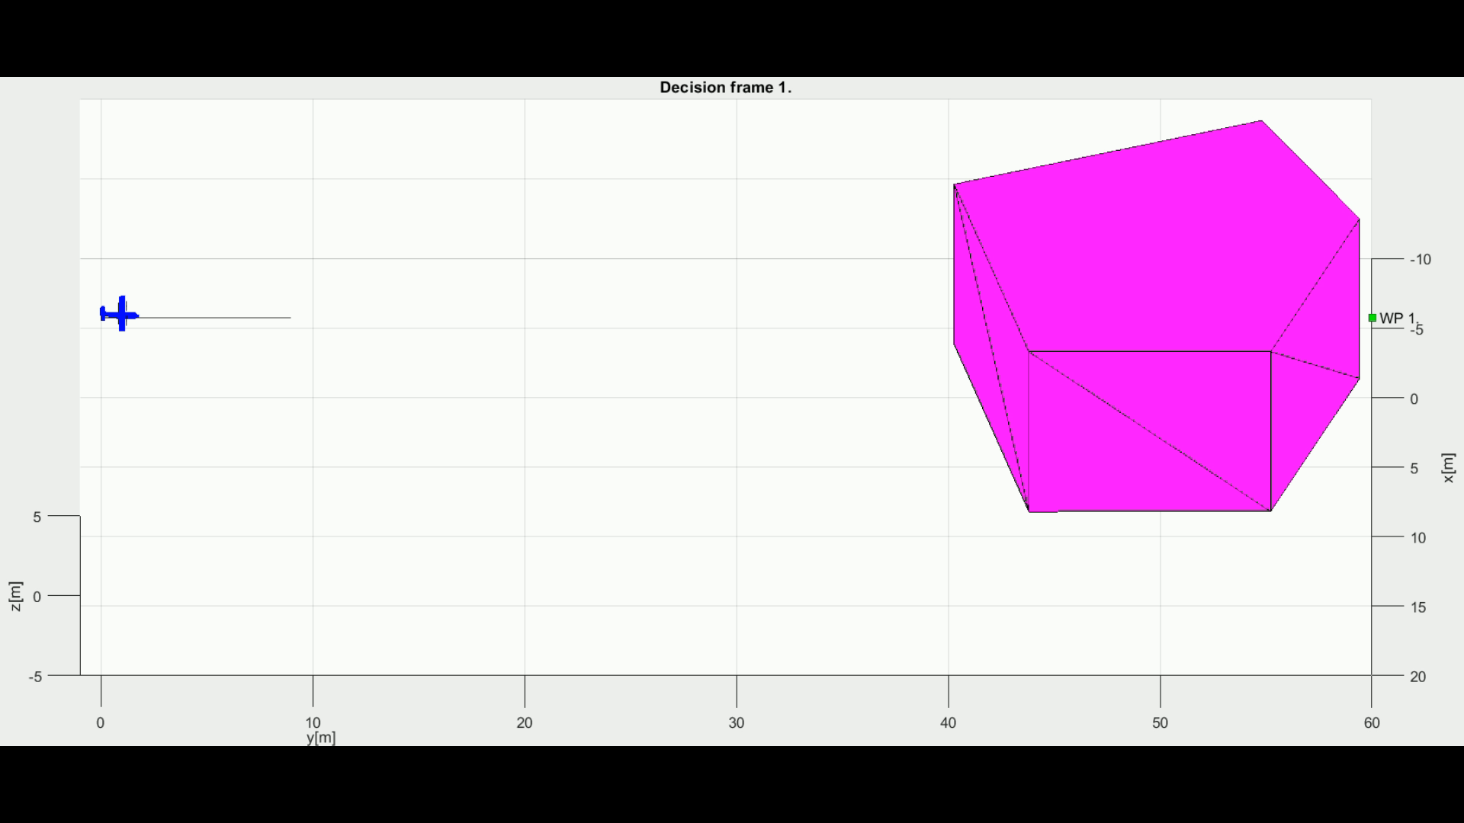
Scenario (7.3.4): Storm
Notes:
Well that was for static obstacles, what about moving ones much bigger than our little plane,
The blue plane is trying to avoid a storm
Framework can also comprehend moving obstacles and constraints

Slide 6
Rules of the Air Simulations: Converging Maneuver Head On Approach Overtake
Notes:
Now lets talk about Rules of the air
Imagine two UAS equipped with our system listening notifications from our UTM

Slide 7

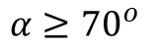
Converging Maneuver - Trigger
$$α≥{70}^{o}$$
Notes:
Converging is similar to T section avoidance
The red plane has right of the way,
the blue one must avoid
Blue circle is expected collision point

Slide 8
Converging Maneuver - Resolution
Turn right and stay away from approaching aircraft
Notes:
Just read what is on slide

Slide 9
Converging Maneuver – Leave condition
Return to original path behind other aircraft
Notes:
Just read what is on slide

Slide 10
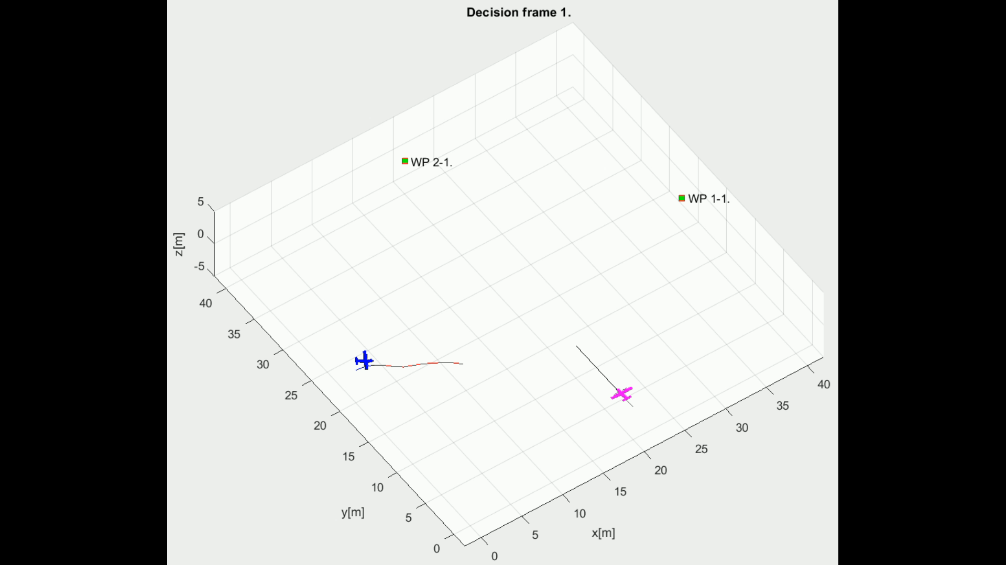
Scenario (7.4.1): Rule-based converging
Notes:
There is example implemented in our framework

Slide 11
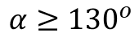
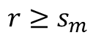
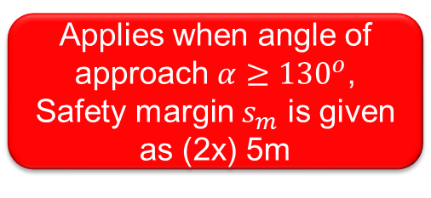
Head On Approach - Trigger
$$α≥{130}^{o}$$
$$r≥s_{m}$$
Applies when angle of approach $α≥{130}^{o}$, Safety margin $s_{m}$ is given as (2x) 5m
Notes:
Now we have Head On situation
Its like virtual roundabout, none of the UAS has right of the way

Slide 12
Head On Approach - Resolution
$$r≥s_{m}$$
Both vehicles are taking right side avoidance
Notes:
Just fly nicely around it

Slide 13
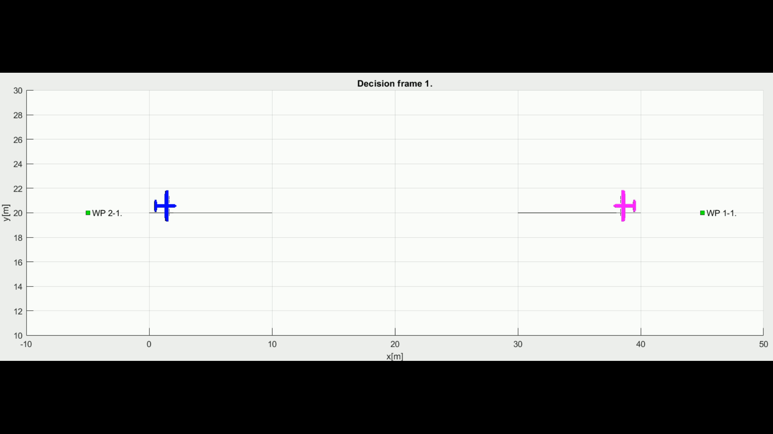
Scenario (7.4.2): Rule-based head-on
Notes:
There is an example of implementation in our framework

Slide 14
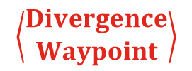
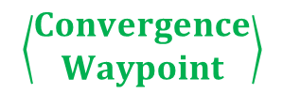
Overtake Maneuver - Trigger
$$\left\langle \begin{matrix}Convergence \\ Waypoint\end{matrix}\right\rangle$$
$$\left\langle \begin{matrix}Divergence \\ Waypoint\end{matrix}\right\rangle$$
The aircraft being overtaken has the right of the way
Notes:
Overtake maneuver very simple,
There is slower red UAS
The blue is very fast and in hurry,
Solution: UTM will calculate red Divergence and Green Convergence waypoint to
enable safe overtake from right
The red UAS has the right of the way

Slide 15
Overtake Maneuver - Resolution
$$\left\langle \begin{matrix}Convergence \\ Waypoint\end{matrix}\right\rangle$$
$$\left\langle \begin{matrix}Divergence \\ Waypoint\end{matrix}\right\rangle$$
Overtake is executed from right

Slide 16
Overtake Maneuver – Leave Condition
$$\left\langle \begin{matrix}Convergence \\ Waypoint\end{matrix}\right\rangle$$
$$\left\langle \begin{matrix}Divergence \\ Waypoint\end{matrix}\right\rangle$$
Overtake rule may apply only when well clear condition is guaranteed
Notes:
Overtake is over and its possible if and only if there is no officially detected hazard for it.

Slide 17
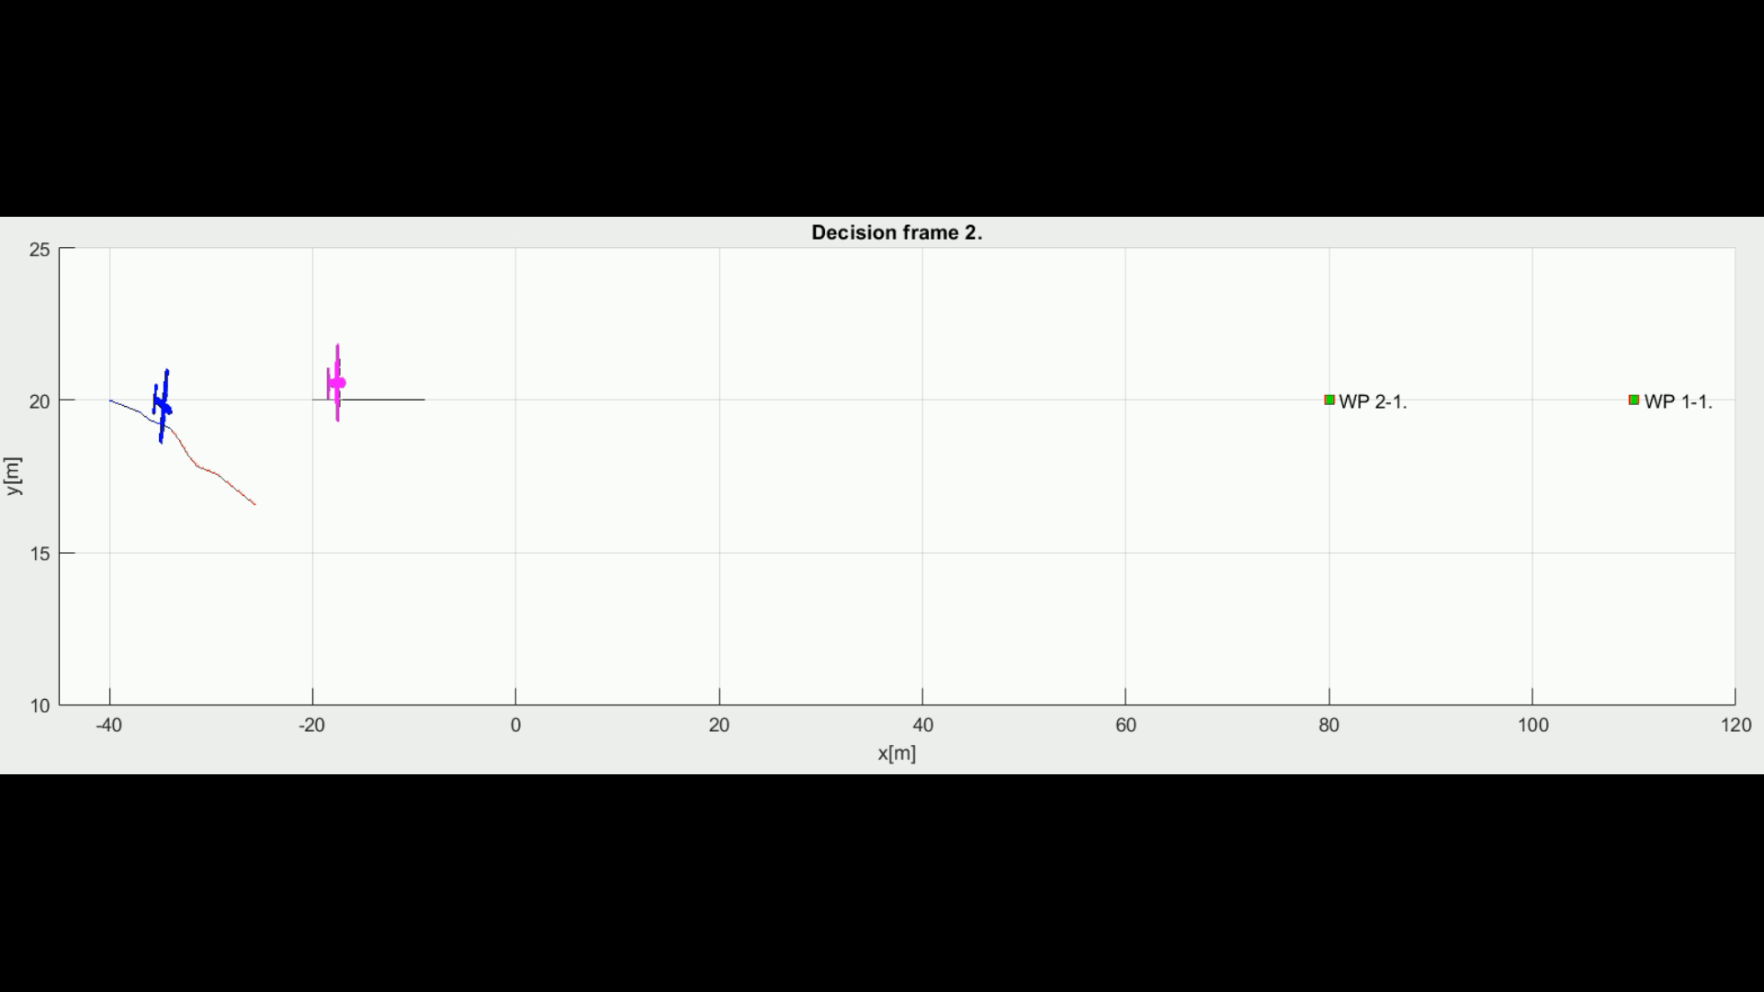
Scenario (7.4.4): Rule-based overtake
Notes:
There is an example of overtake

Slide 18
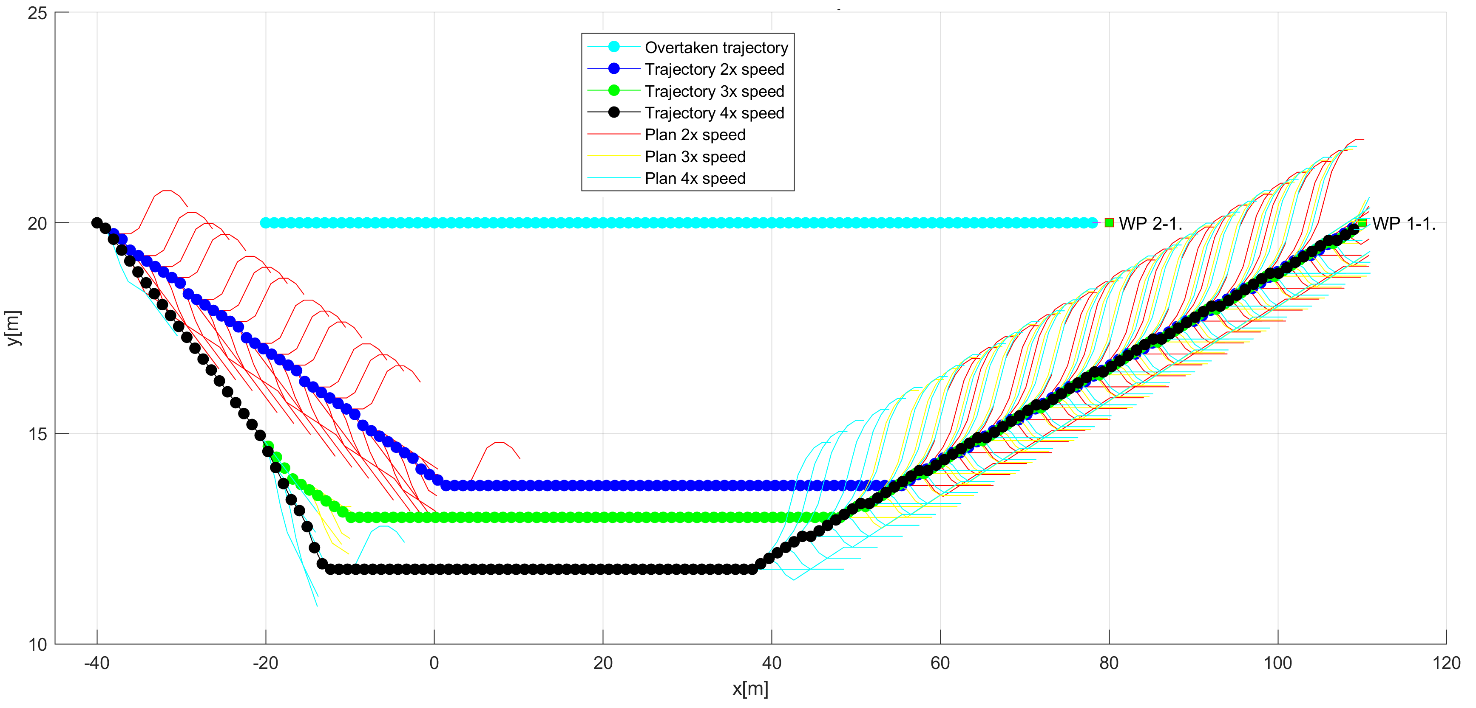
Different speed: Overtake Maneuver
Notes:
The speed difference changes the shape of overtake trajectory,
The turn angle and shape is getting more sharp
Blue trajectory shows overtake with 2x speed difference
Green trajectory shows overtake with 3x speed difference
Black trajectory shows overtake with 6x speed difference.

Slide 19
Simulations: Cooperative vs. Noncooperative Multi-Collision Situations
Notes:
There are two modes Cooperative and non cooperative,
our solution supports both

Slide 20
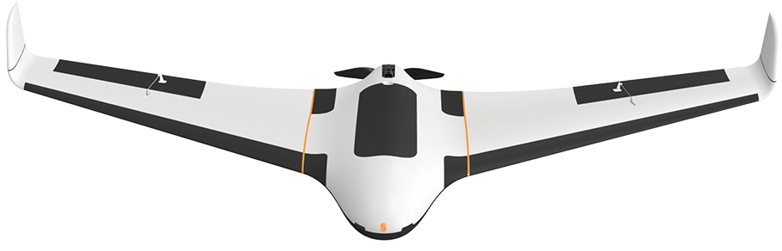
Cooperative separation scenario
Position Notification
Position Notification
UAS 1
2
UAS 3
1
Calculate collision Cases
Create Virtual
Roundabout
Directive
Directive
UAS Traffic Management
Directive
Directive
Send
Directives
Enforce
Directives
3
4
UAS 2
UAS 4
Position Notification
Position Notification
Notes:
First I will start with Cooperative example,
Each UAS is sending the position notification to UAS Trafic Management
UAS Trafic management:
Calculates Collision Cases,
Creates solution
Send Directives and Monitor directives

Slide 21
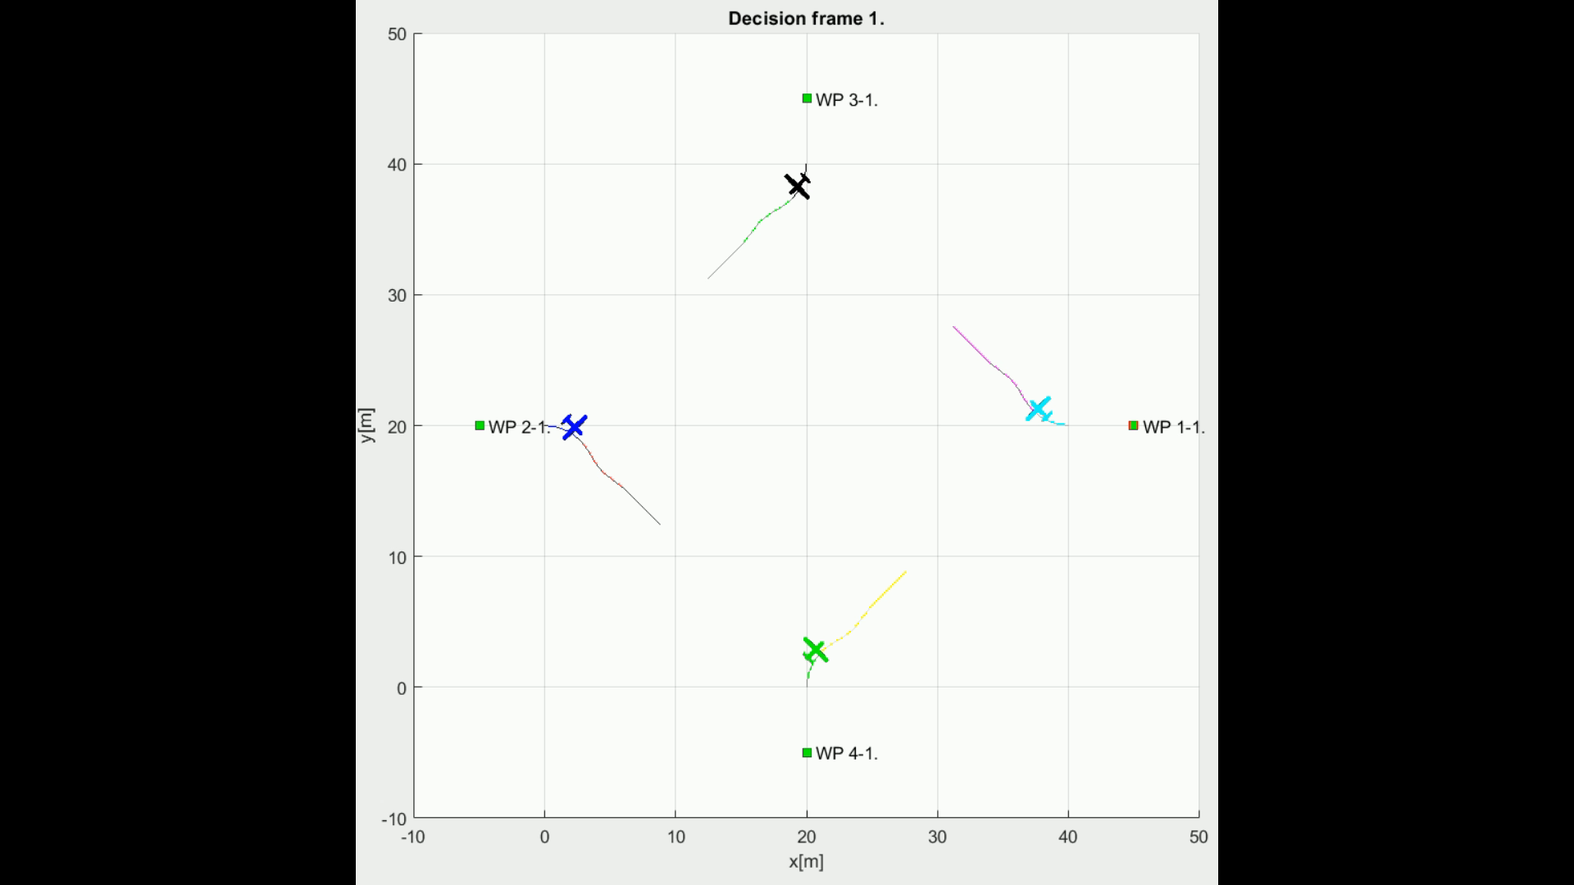
Scenario (7.4.3): Rule-based mixed head-on with converging
Notes:
There is an example how its done
You can see UAS nicely flying around in polite manner

Slide 22
Non-cooperative separation scenario
Alert
UAS 1
UAS 3
Alert
Response
Consensus
UAS 1: Horizontal Separation
UAS 2: Vertical Separation
UAS 3: Horizontal Separation
UAS 4: Vertical Separation
Response
Alert
UAS 2
Response
UAS 4
Notes:
Now lets get to non cooperative mode,
Each UAS is detecting own collisions, alerting others trough ADS-B
Each UAS is using our statistical engine to calculate own avoidance trajectory
which gave them best possible odds of survival

Slide 23
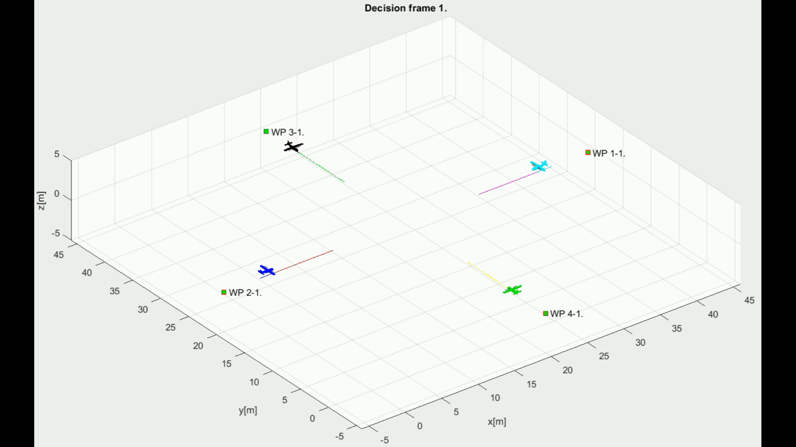
Scenario (7.3.7): Emergency mixed head-on with converging
Notes:
There is a simulation,
Our advanced statistical model enables to use preffered separation modes, which makes them go really wild
At the one moment you can see that they nearly collided

Slide 24
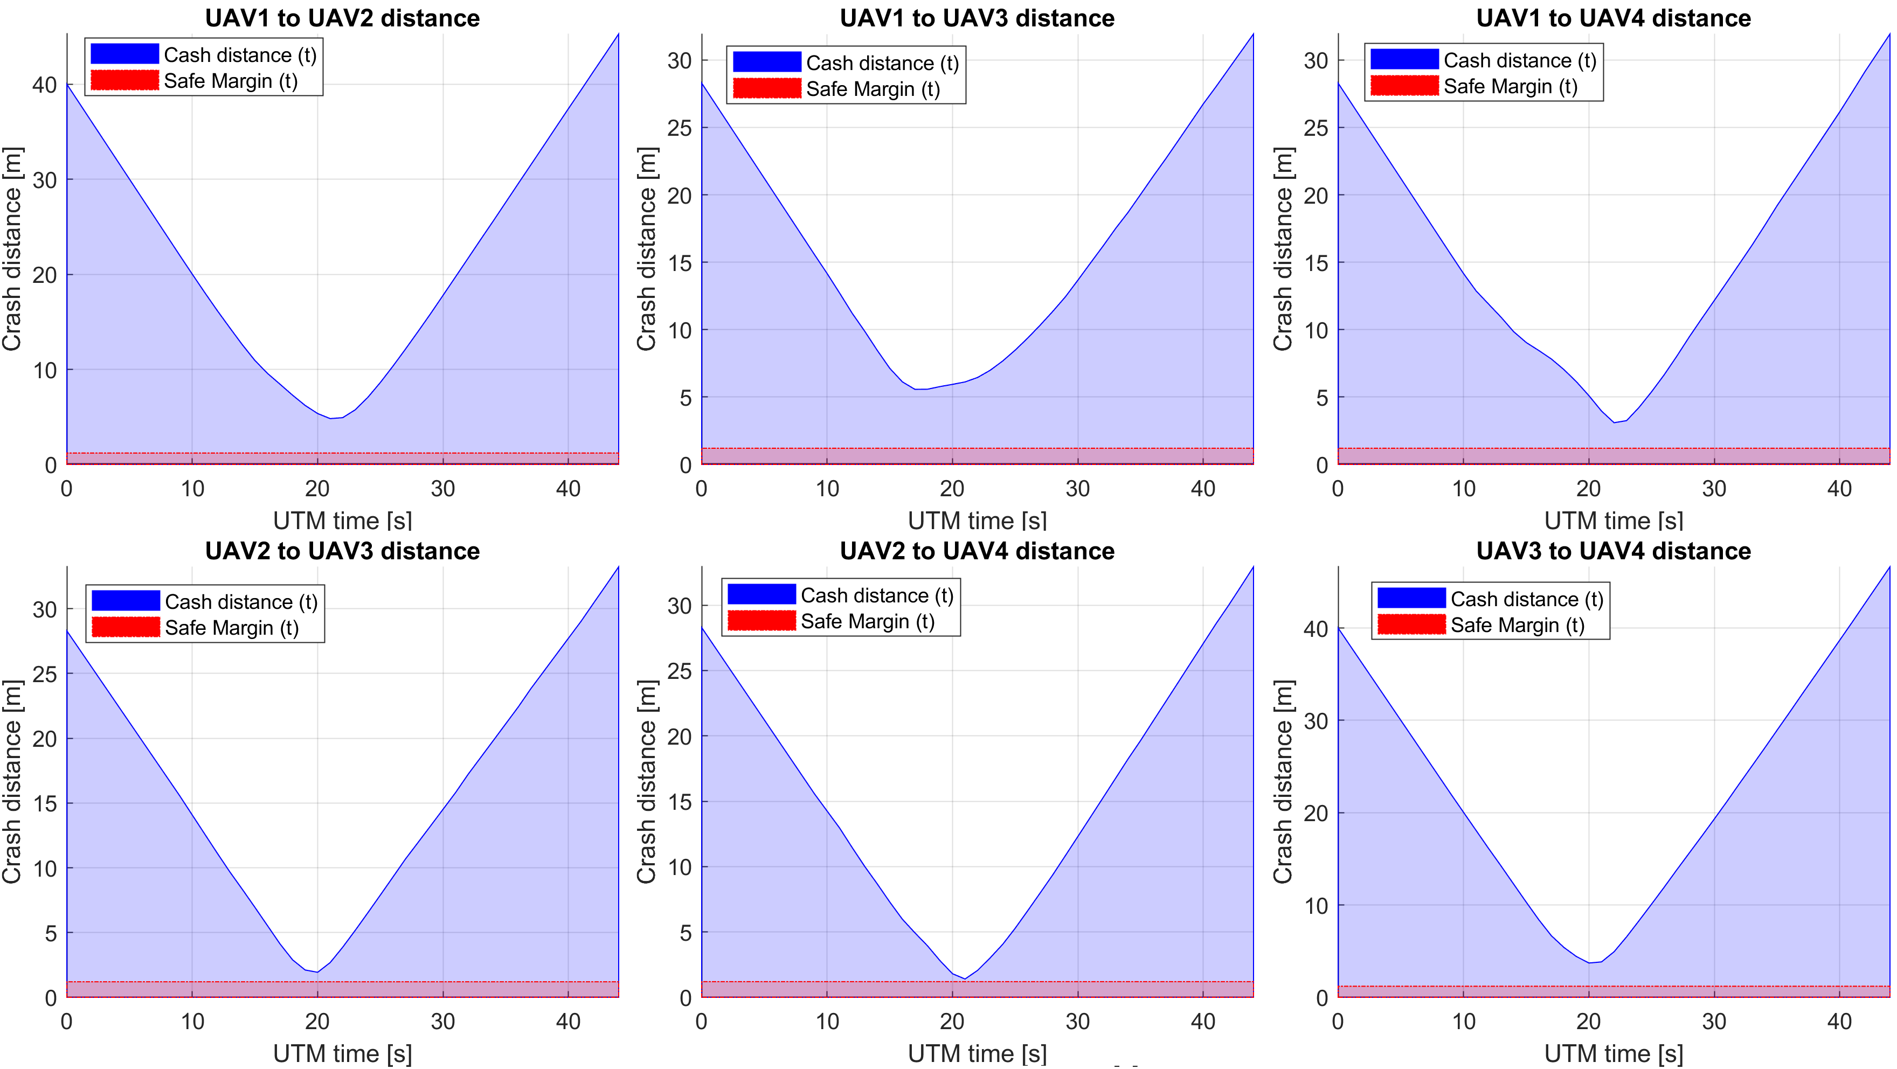
Performance: Non-cooperative separation scenario
Notes:
But that is not true
The mutual distance represented by blue line
Never went under collision margin represented by red line

Slide 25
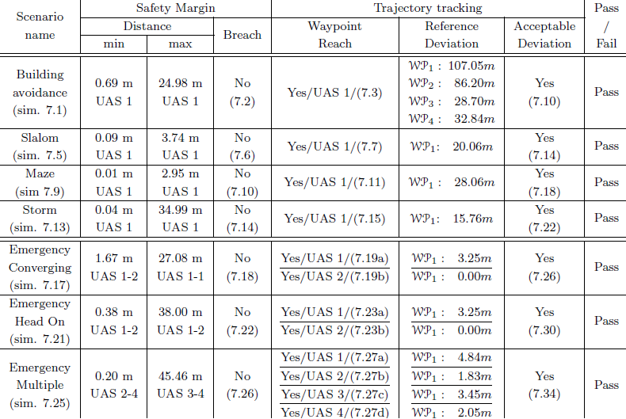
Simulations results – non-cooperative

Slide 26
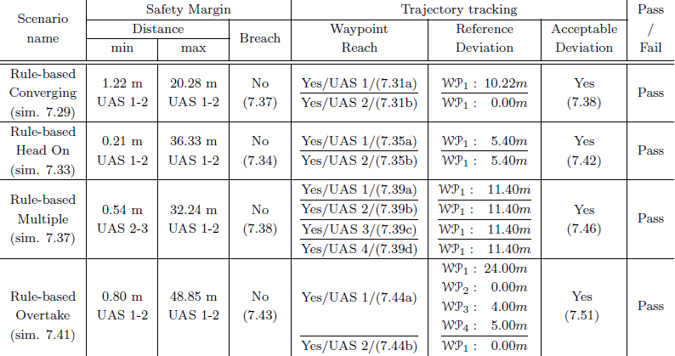
Simulations results – cooperative

